Slide 1
DISTRACTED DRIVER DETECTION USING CNN
Sairam Cholleti(242CS014)
Arjun Thulaseedhar (242CS010)
Ayush Nigam (242CS012)

Slide 2
INTRODUCTION
Majority of road accidents are caused by distracted drivers like looking in the phone, talking with passengers etc.
If we can detect these distractions and alert the drivers, we can avoid a lot of these accidents.
So our task is to detect distractions from images, similar to classification task.
Capture images from dashcam inside the car
For this task we can use deep learning models like CNN which are especially helpful in image classification tasks.

Slide 3
DATASET
State Farm Distracted Driver Detection Dataset
Almost 22000 images(4.3 GB)
Images are of 9 classes:
c0: safe driving
c1: texting - right
c2: talking on the phone - right
c3: texting - left
c4: talking on the phone - left
c5: operating the radio
c6: drinking
c7: reaching behind
c8: hair and makeup
c9: talking to passenger

Slide 4
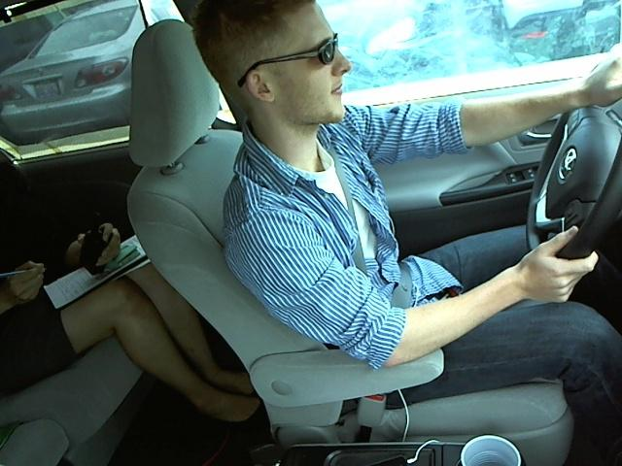
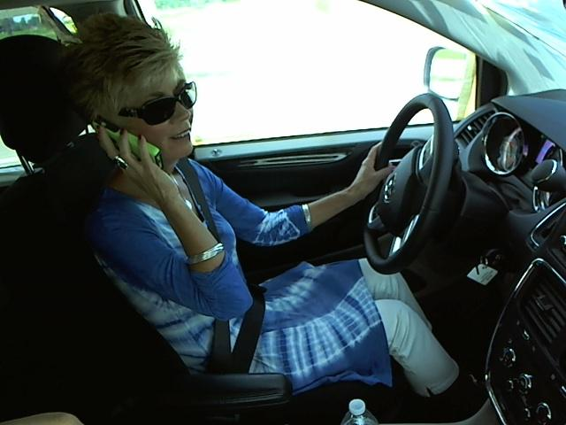
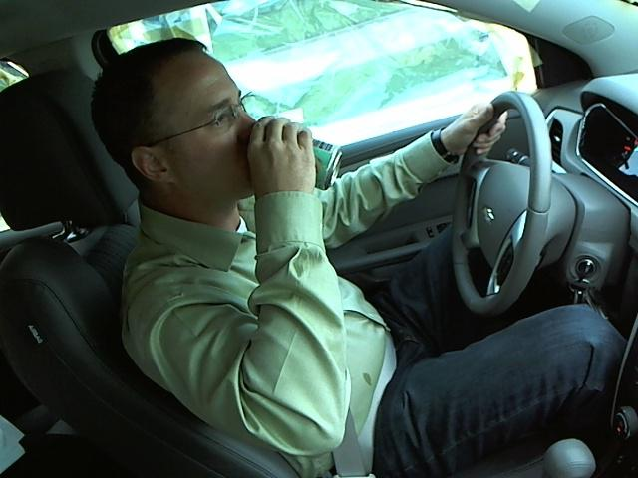
DATASET
c0: Safe Driving
c2: Talking on phone right
c6: Drinking

Slide 5
METHODOLOGY
We are using 3 CNN models:
VGG16
DenseNet
ResNet50
Built the models and trained them on the training images(Dataset already split into train and test)
Evaluated the model against the test images
We have used pre-trained models (trained on ImageNet) and updated the last layer to classify the input into the 10 defined classes

Slide 6
EVALUATION METRICS
Accuracy: Ratio of Number of Correct predictions to the total number of predictions
Micro F1 score: The harmonic mean of precision and recall calculated globally across all classes,

Slide 7
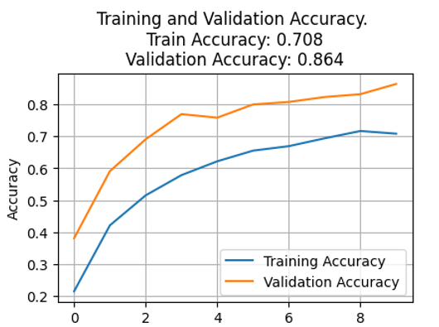
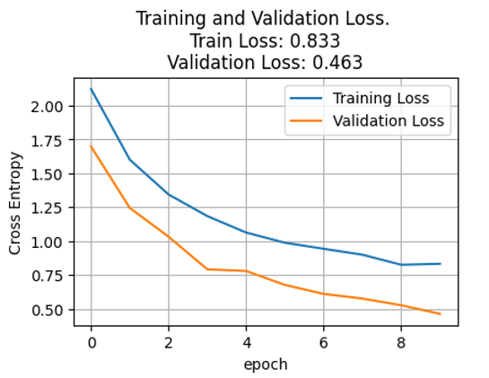
RESULTS (VGG16)

Slide 8
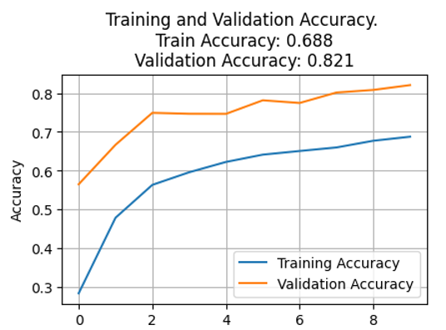
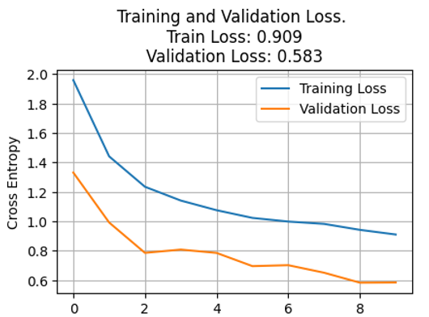
RESULTS (DenseNet)

Slide 9
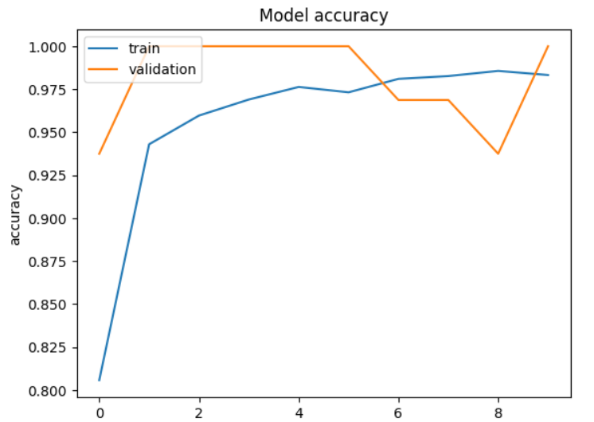
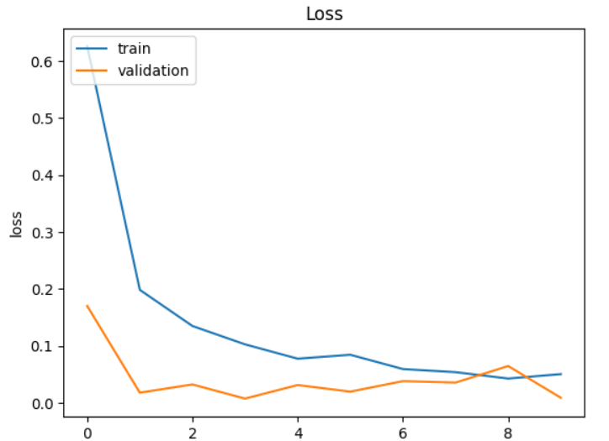
RESULTS (ResNet50)

Slide 10
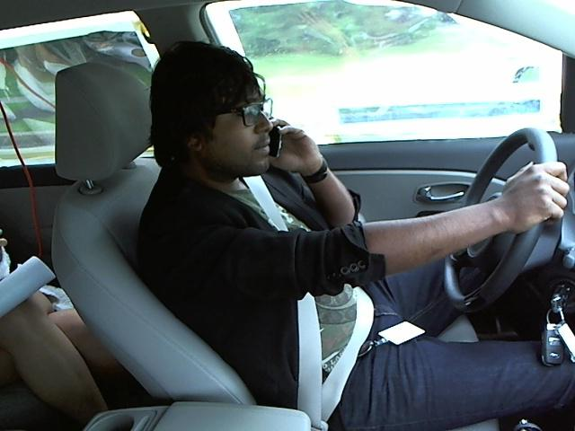
Sample Prediction

Slide 11
Results
 | VGG 16 | DenseNet | ResNet
Number of layers | 16 | 121 | 50
Number of Parameters | 14,789,258 | 7,093,962 | 23,828,362
Loss function | Cross Entropy | Cross Entropy | Cross Entropy
Optimization function | Adam | Adam | Adam
Measures for reducing overfitting | Early Stopping, Dropout. Image augmentation | Early Stopping, Dropout. Image augmentation | Dropout, Image Augmentation
Accuracy | 86.4% | 82.1% | 98%
Micro F1 Score | 0.8640 | 0.8085 | 0.8835

Slide 12
Thank You!

